Slide 1



Rajasthan Police Hackathon 1.0
COPCONNECT INSIGHTS
Problem statement : 1
Develop a Police Feedback System

Slide 2
PROBLEM STATEMENT
Getting feedback on police operations is difficult due to outdated methods and privacy concerns. Traditional ways like inspections and calls to complainants are restricted and lack inclusivity. This hampers understanding community feelings and addressing policing issues effectively.
Getting feedback on police operations is difficult due to outdated methods and privacy concerns. Traditional ways like inspections and calls to complainants are restricted and lack inclusivity. This hampers understanding community feelings and addressing policing issues effectively.

Slide 3
OUR MOTTO
Empowering Voices, Ensuring Privacy, Combating Discrimination. Our online Complaint Registration portal stands against discrimination based on society and caste. Your complaints are confidential, and we provide a unique ID for feedback, prioritizing your privacy throughout the process.

Slide 4
SOLUTION
COMPLAINT SPECIFIC FEEDBACK
GENERAL FEEDBACK
COMPLAINT REGISTRATION
In this project, privacy is given top priority in the online Complaint Registration portal, ensuring confidentiality for details such as the nature of the complaint, the subject, and the complainant's identity.
Provide feedback on the normal functioning of the police in public
Users can provide feedback on a particular complaint they previously submitted through the portal.

Slide 5
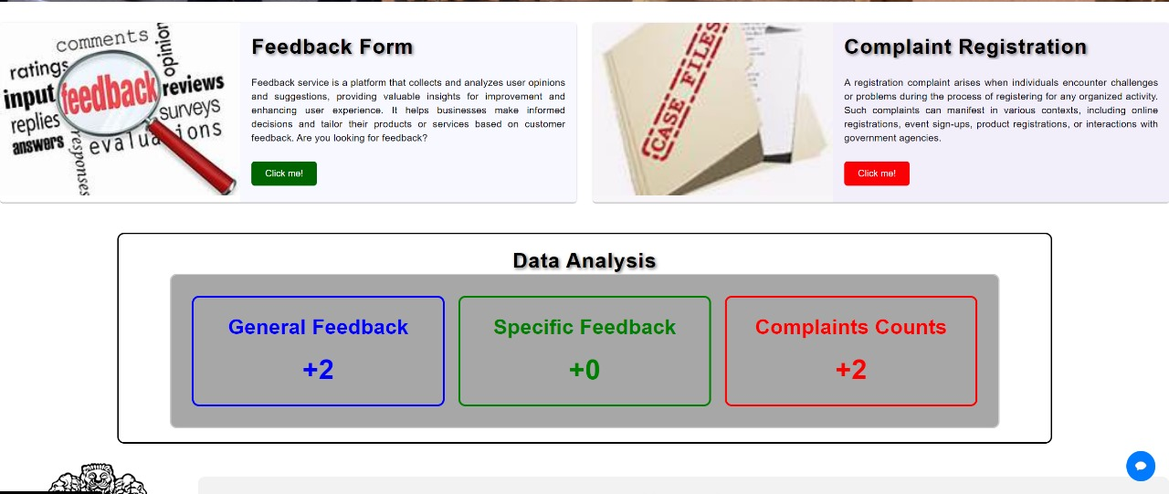
1. FEEDBACK FORM
2. COMPLAINT REGISTRATION
3. DATA ANALYSIS

Slide 6
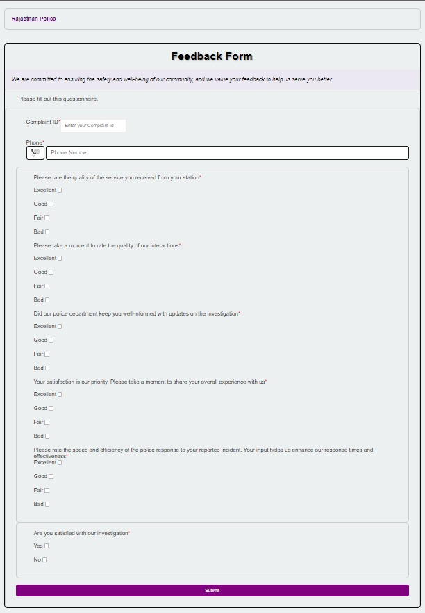
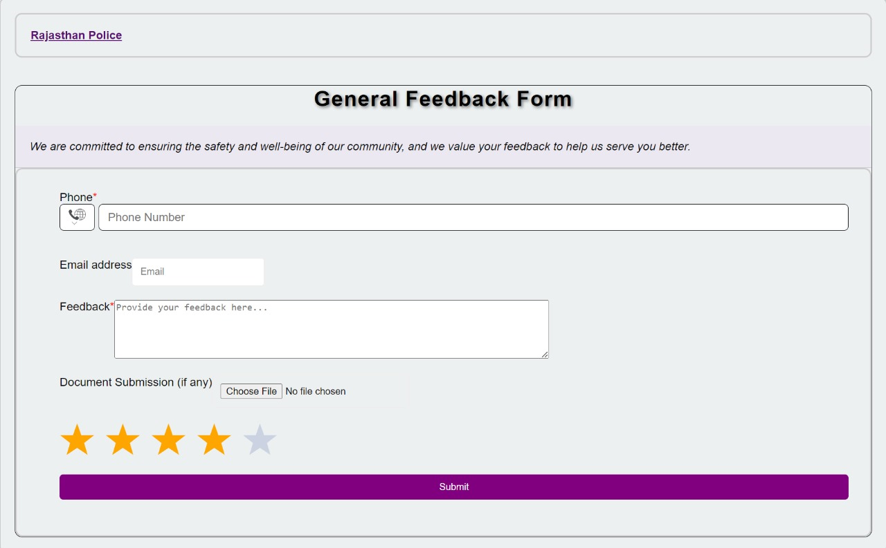

Slide 7
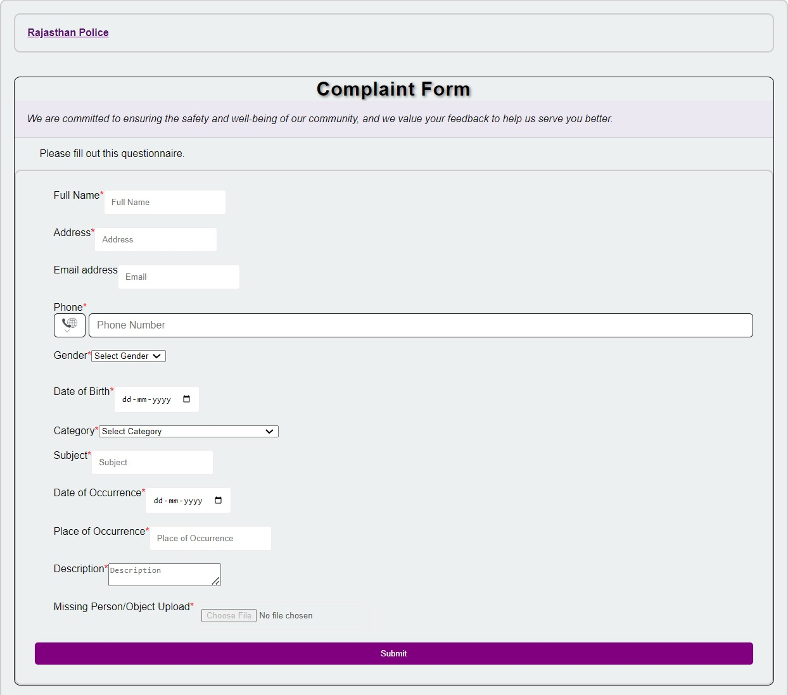

Slide 8
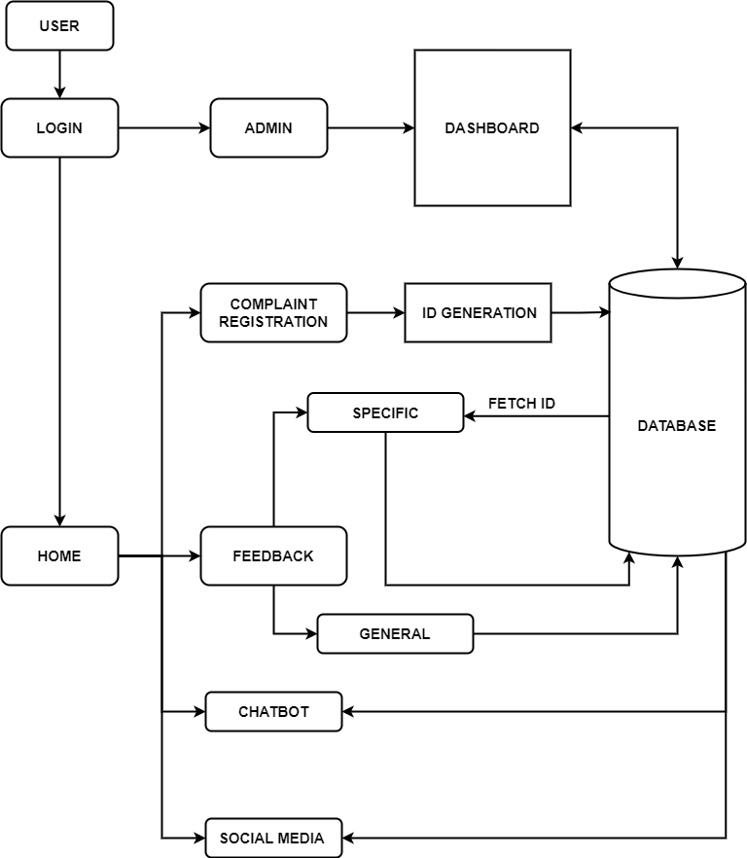
WORKFLOW

Slide 9


LOGIN COMPONENTS
USER LOGIN
ADMIN LOGIN
Users can access Login, Complaint Registration, Feedback, and News and Events functionalities
The admin has access to the Dashboard, Recently Solved Cases, Leaderboard, and Feedback Responses.

Slide 10

ADMIN LOGIN
This section contains user feedback, with personal details securely hidden for privacy.
FEEDBACK RESPONSES
Inspecting officers are positioned on the leaderboard based on feedback received from specific cases or scenarios.
LEADERBOARD

Slide 11


CHATBOT
This project incorporates a chatbot to facilitate seamless user navigation and enhance the overall experience on our portal.

Slide 12
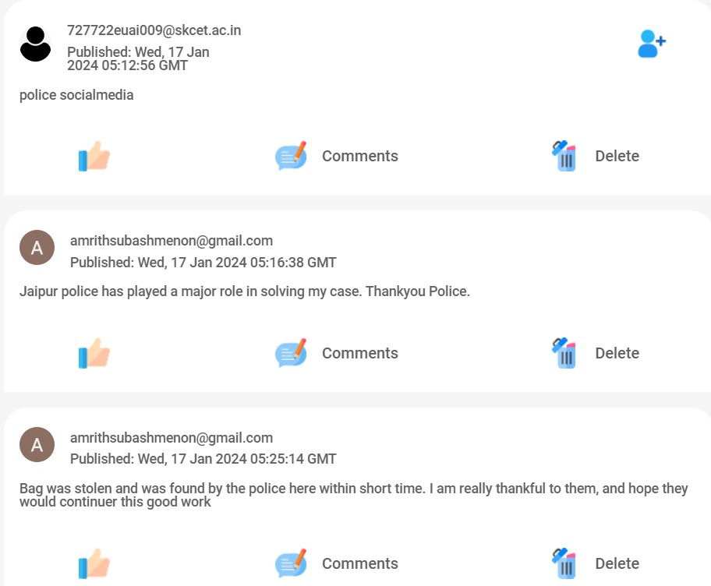

COP MEDIA SERVICE
This project has established a platform resembling social media, enabling users to share specific issues or comments anonymously without revealing personal information. Furthermore, users possess the capability to tag the adjacent police station.

Slide 13
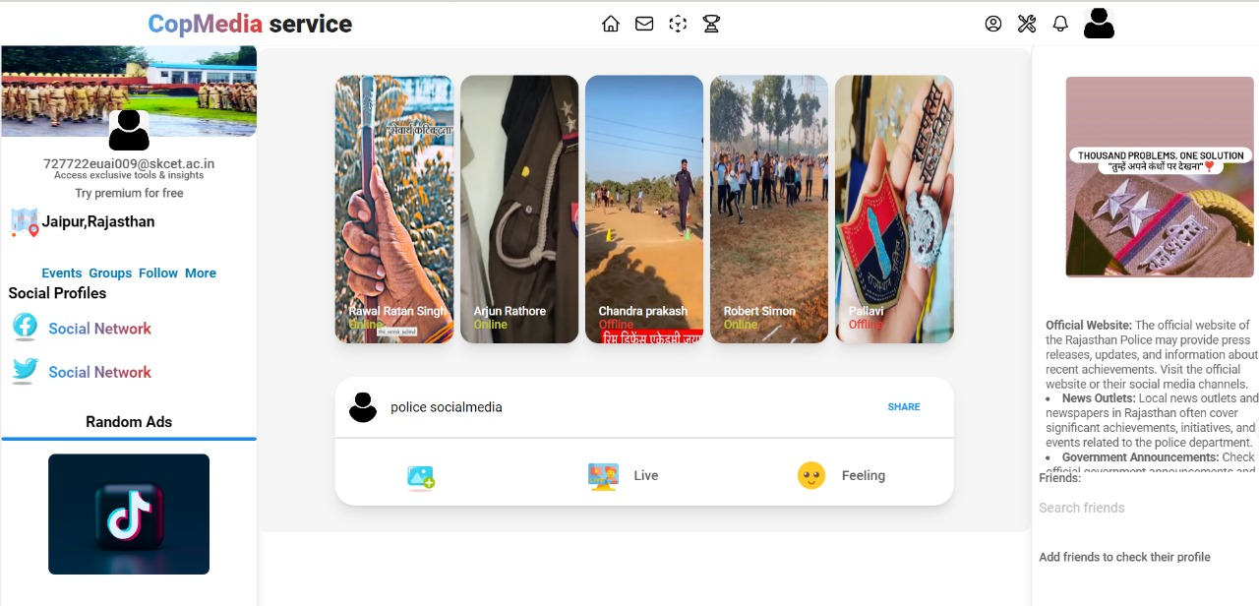
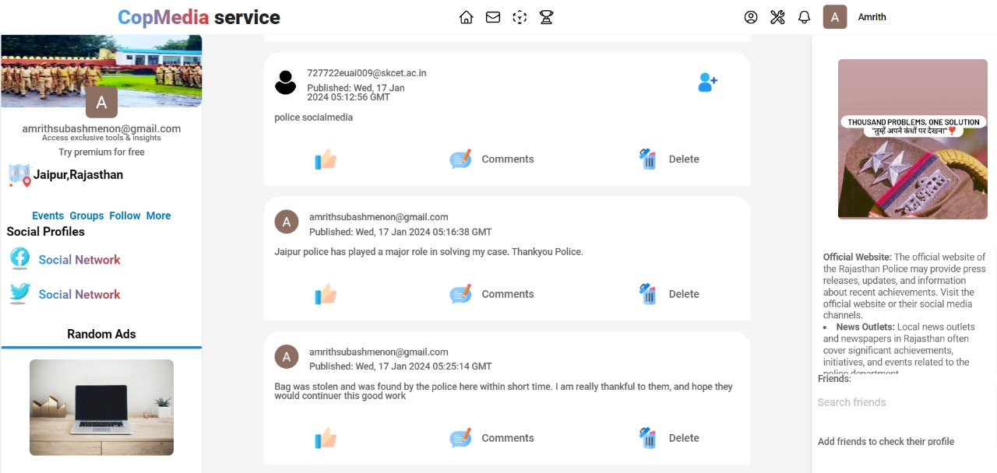

Slide 14

MULTI LINGUAL WEBPAGE
To guarantee accessibility for individuals with low literacy levels, this project includes functionality that translates webpage content into regional languages.

Slide 15
TECHNICAL STACK
FRONT-END FRAMEWORKS
React js, Bootstrap, CSS
BACK-END
Firebase API
NLP for Multi-Lingual translation of the webpage
DATA STORAGE
Firebase - Real time cloud database

Slide 16

REFERENCES
SCOTLAND POLICE WEBSITE
https://consult.scotland.police.uk/yourfeedback/
TAMILNADU POLICE WEBSITE
https://eservices.tnpolice.gov.in/CCTNSNICSDC/ComplaintRegistrationPage?0
SINGAPORE POLICE WEBSITE
https://eservices.police.gov.sg/content/policehubhome/homepage/police-report.html

Slide 17

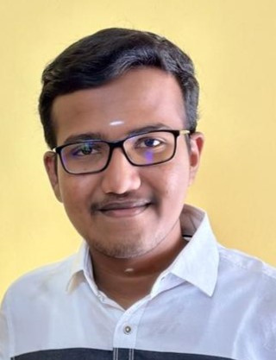

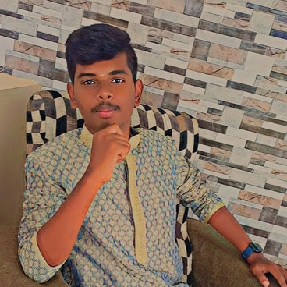

OUR TEAM
Mr.Amrith Menon S
Ms.Brinda PV
Mr.Logesh S
Mr.Bharath V

Slide 18
THANK YOU

